Slide 1
Alexa Spying
Ethics_Project_Group_13
Amal Raj Mathur, Jason Paul, Yiqing Huang
Zhiyuan Lu, Zuyue Xie

Slide 2
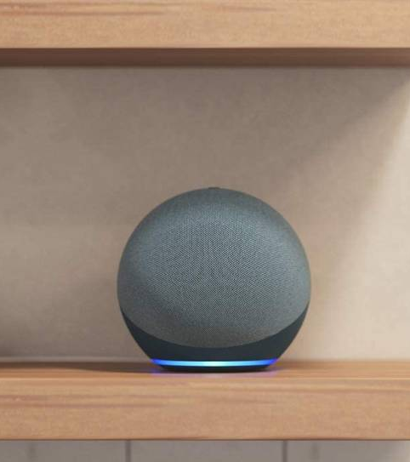


Slide 3

FEAR
of privacy invasion

Slide 4
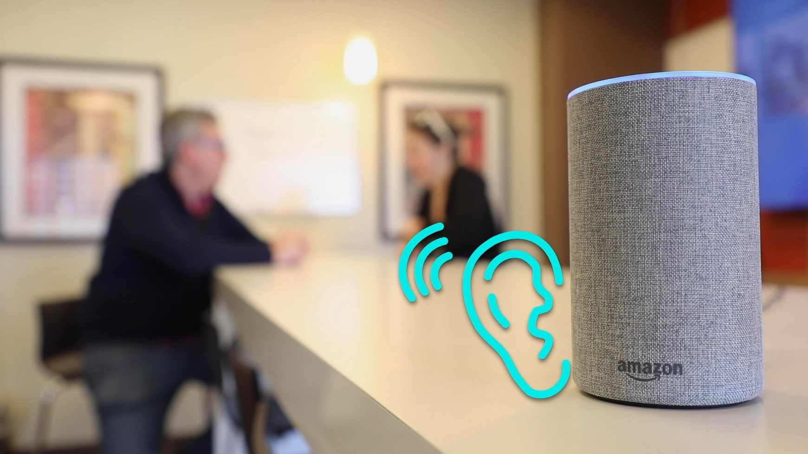
What MAKES ALEXA Interesting ?
The name Alexa was chosen because it has the consonant "X" and is reminiscent of the Library of Alexandria.
Amazon accounts for 70% of market for smart speakers.
Echo, Amazon's smart speaker, is an omnipresent inconspicuous listener at home.
Smart Tech transforming to Surveillance Tech.
In order to improve efficiency, voice recordings are transcribed by amazon employees.
Technology needs data to evolve and improve.

Slide 5
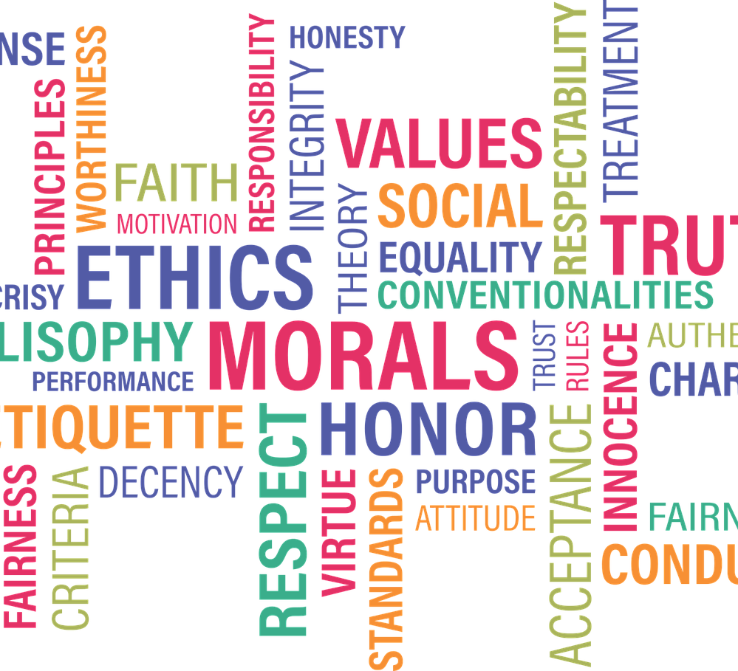
Ethical Significance
Ownership
Transaction Transparency
Consent
Data Privacy
Currency

Slide 6

Personal impact
Leak of privacy, such as sex, medical and purchase record.
Alex monitor your conversation
Alex may send your purchase data to Advertising company
Private data Alex collected may cause fraud

Slide 7
Public impact
Before the huge interest, those big companies would like to ignore the privacy protection which should be considered seriously.
How to regulate the use data and customer privacy are the problem for politicians to consider rather than blame big companies.

Slide 8
consequENce
Positive side: Alex does provide us the convenience.
Nagative side: Privacy is not being treated properly
Solution: Apple brought about methods to protect data. Thus, when leaking happens we should consider the way to improve to fix the problems.

Slide 9

Was This Preventable?
Yes, although it is challenging
Government regulation can play a role in checks and balances to some extent
GDPR, CCPA, ENISA, etc.

Slide 10
References
Priest, D. (2020, October 30). Amazon Echo (2020) review: This new Alexa smart speaker rolls the competition. CNET. https://www.cnet.com/home/smart-home/amazon-echo-2020-review-this-new-alexa-smart-speaker-rolls-the-competition/
Fowler, G. A. (2019, May 6). Alexa has been eavesdropping on you this whole time. Washington Post. https://www.washingtonpost.com/technology/2019/05/06/alexa-has-been-eavesdropping-you-this-whole-time/
The Daily Dot. (2021, May 21). Alexa, Are You Spying on Me? https://www.dailydot.com/debug/alexa-smart-speaker-vulnerabilities/
Wikipedia contributors. (2021, October 21). Big Brother (Nineteen Eighty-Four). Wikipedia. https://en.wikipedia.org/wiki/Big_Brother_(Nineteen_Eighty-Four)
Todd Bishop.(2021, August 4). Amazon maintains big lead over Google and Apple in U.S. smart speaker market, new study says.GeekWire. https://www.geekwire.com/2021/amazon-maintains-big-lead-google-apple-u-s-smart-speaker-market-new-study-says/
Day, M (2019, April 11). Thousands of Amazon Workers Listen to Alexa Users' Conversations. TIME https://time.com/5568815/amazon-workers-listen-to-alexa/
Morford, Stacy.(2020, January 1). Amazon Echo's privacy issues go way beyond voice recordings. https://theconversation.com/amazon-echos-privacy-issues-go-way-beyond-voice-recordings-130016
Cybersecurity Act. (2021, November 17). Shaping Europe’s Digital Future. https://digital-strategy.ec.europa.eu/en/policies/cybersecurity-act
Galvagna, C. (2018, February 27). Not yet in effect, Europe’s new data protection rules already face overseas threats. Www.Euractiv.Com. https://www.euractiv.com/section/digital/opinion/for-monday-overseas-threats-to-gdpr-protections/
Deckson, Bin(2019, Oct 19). Alexa, Are You Spying on me. https://www.theguardian.comhttps://www.dailydot.com/debug/alexa-smart-speaker-vulnerabilities/
Z. (2018, August 21). Getting Justice When Your Privacy is Invaded. J&Y Law Firm. https://jnylaw.com/getting-justice-privacy-invaded/

